Slide 1

CHƯƠNG TRÌNH ĐÀO TẠO NHÂN VIÊN
MÔN HỌC: Javascript
AngularJS
Trình bày: SonVQ
HANOI – MAY, 2016

Slide 2

What is Yeoman
The web's scaffolding tool for modern webapps
Kickstart new projects productively
Provide best practices, workflow, generator & tools
Support linting, testing, minification
and much more…
Notes:
Linting is the process of running a program that will analyse code for potential errors.

Slide 3
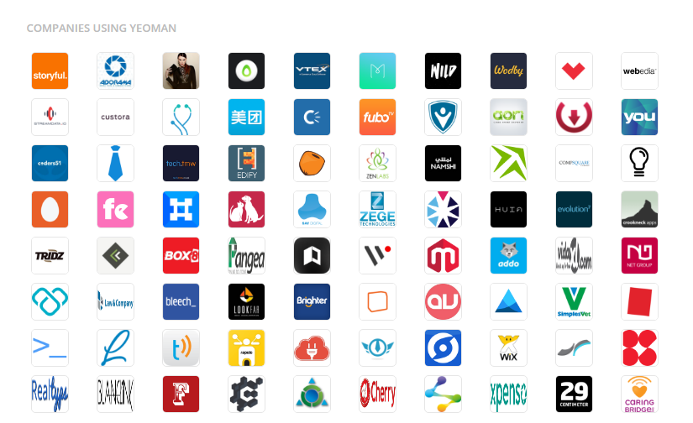
Who using Yeoman
Notes:
Linting is the process of running a program that will analyse code for potential errors.

Slide 4

Yeoman tools
Scaffolding tool for contruct new app (Yo)
Build system for build, preview, test (Grunt, Gulp)
Package manager for dependency management (Bower, npm)
Notes:
Linting is the process of running a program that will analyse code for potential errors.

Slide 5

Yeoman features
Lightning-fast scaffolding
Easily scaffold new projects with customizable templates
Great build process
Minification and concatenation
Optimize image, HTML, compile CoffeeScript &Compass files
Built-in preview server
Fired up Built-in server with just one command
LiveReload auto watch, compile & refresh browser
Automatically lint scripts
Use JSHint to ensure following language best-practices
Notes:
Linting is the process of running a program that will analyse code for potential errors.

Slide 6

Yeoman features
Awesome Image Optimization
Optimize images using OptiPNG & JPEGTran
Killer package management
Easily search new packages via cmd, install & keep them updated
PhantomJS Unit Testing
Easily run unit tests in WebKit via PhantomJS
Notes:
Linting is the process of running a program that will analyse code for potential errors.

Slide 7

The old-fashioned Workflow
Find an HTML Boilerplate
Download & add it to project
Find a UI Boilerplate
Download & add it to project
Download project libs, add 'em
Copy boilerplate for models,views, setup
Setup test runner
Setup build process
Write Real Code!
Notes:
Linting is the process of running a program that will analyse code for potential errors.

Slide 8
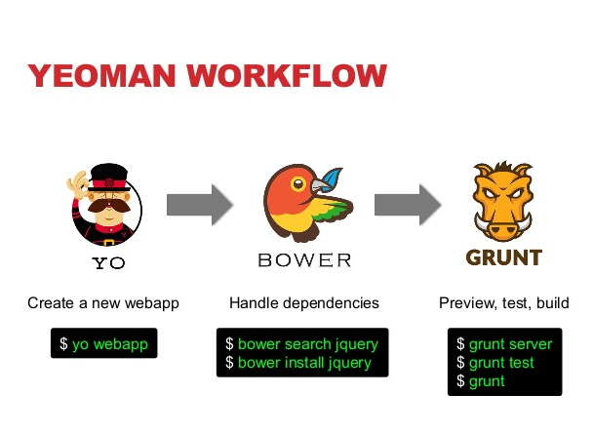
Yeoman workflow
Notes:
Linting is the process of running a program that will analyse code for potential errors.

Slide 9

Is yeoman better?
HTML5 Boilerplate
Twitter Bootstrap
AngularJS
Karma Testrunner
Scaffolding for Models, Directives, Routes, Views, Values, Constants, Services, Factories, ...
DI-aware JavaScript minification
CoffeeScript support
Notes:
Linting is the process of running a program that will analyse code for potential errors.

Slide 10

Scaffolds out a new application
Writing build configuration (e.g Gruntfile, Gulpfile)
Pulling relevant build tasks & package manager dependencies (Bower, npm) that needs for build.
Notes:
Linting is the process of running a program that will analyse code for potential errors.

Slide 11

Automatic Build system for web app
Minify code, compile, unit test, validate, etc.
Extendable
Notes:
Linting is the process of running a program that will analyse code for potential errors.

Slide 12

clean: delete previous build
copy: copy folder staging (intermediate/) to (publish/)
css: replace @imports, concat & minify CSS into 1 file
html: minify HTML
img: optimize .png/.jpg by OptiPNG/JPEGtran
mkdirs: prepare build folders
rev: auto rename build files by revision
usemin: replace reference to use optimized CSS, JS and assets
Notes:
Linting is the process of running a program that will analyse code for potential errors.

Slide 13

Package Manager is used for dependency management
Don’t have to manually download and manage scripts
Bower and npm are two popular options
Written by Twitter Inc
Notes:
Linting is the process of running a program that will analyse code for potential errors.

Slide 14

3 commands:
bower search [package_name]
bower install [package_name]
bower uninstall [package_name]
There are about 27372 bower components (25 May 2016)
http://sindresorhus.com/bower-components
Notes:
Linting is the process of running a program that will analyse code for potential errors.

Slide 15
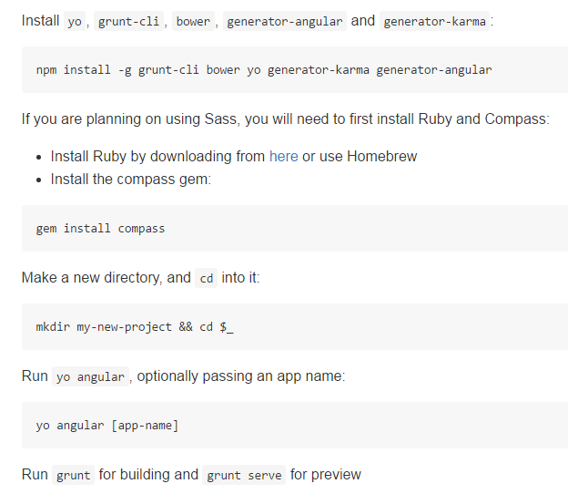
AngularJS generator

Slide 16
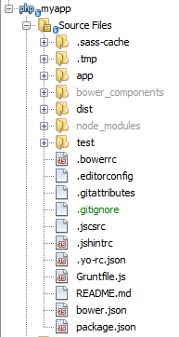
Project structure

Slide 17
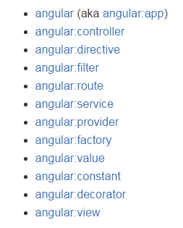
AngularJS generator
https://github.com/yeoman/generator-angular

Slide 18
Demo
Generate skeleton app
yo angular:route hello
yo angular:directive hello
yo angular:controller hello
yo angular:view hello
Preview application with built-in server
grunt server
Build application
grunt build

Slide 19
THANK YOU!

